Slide 1



Machine Learning Pipeline
Presentation By: Regan Muthomi
AFRICA DATA SCHOOL

Slide 2
What is Machine Learning?
Machine learning is a branch of artificial intelligence (AI) and computer science which focuses on the use of data and algorithms to imitate the way that humans learn, gradually improving its accuracy.
©2021 Proprietary and Confidential. All Rights Reserved.
2

Slide 3

Top-Down ML Pipeline
Testing & Deployment
Data Preprocessing
Feature Engineering
Feature Selection
Model Building
Data Gathering & Data Analysis (EDA)
©2021 Proprietary and Confidential. All Rights Reserved.
3

Slide 4
Data Gathering
Process of gathering and measuring information,
on variables of interest.
©2021 Proprietary and Confidential. All Rights Reserved.
4

Slide 5
Collecting data for ML If you don't have any
Open Source Datasets
Collect data the right way
Big Data
Not about petabytes but the ability to process them right away.
Larger dataset are harder to yield insights. Start small and reduce complexity of the data.
Companies like Google are ready to give away data for Machine Learning.
Real value is in internally collected data.
Data collection with paper ledgers, (.xlsx, .csv files)
Harder time with data preparation, but ML-friendly dataset.
©2021 Proprietary and Confidential. All Rights Reserved.
5

Slide 6
Data Analysis (EDA)
An approach to analyzing data sets to summarize their main characteristics, often with visual methods.
©2021 Proprietary and Confidential. All Rights Reserved.
6

Slide 7




1
Gain intuition about the data.
2
Conduct sanity checks to ensure you're applying the right dataset.
3
Find out missing data and check any outliers.
4
Summarize the data.
©2021 Proprietary and Confidential. All Rights Reserved.
7

Slide 8





Steps in EDA
Missing Value Treatment
Variable Identification
Univariate Analysis
Bivariate Analysis
Detecting Outliers
Discovering variable types
Individual characteristics of each feature.
Relationship between any two variables.
Find out if there is any specific reason why these values are missing and how we treat them
Understand presence of outliers.
©2021 Proprietary and Confidential. All Rights Reserved.
8
Notes:
Always Be Prioritizing Don't fall victim to "check-list" marketing. That is, don't feel compelled to create a giant list of all the marketing activities you can possibly execute. Hold on to the focus you established with your Big Goal and Growth Plan. Pick the 3 most important aspects of your marketing plan that will drive 80% of your results. Position these as your big levers. You will not be derailed from making them a success.

Slide 9
Types of Variables (Univariate Analysis)
Continous Variable
Graphical Technique
Numeric variables thats have infinite number of values between any two values.
Histogram
KDE
Box Plots, Q-Q Plot (outliers)
Categorical Variable
Graphical Technique
Nominal variable; one that has two or more categories.
Bar Plot
Pie Chart
Frequency Table
©2021 Proprietary and Confidential. All Rights Reserved.
9

Slide 10







Relationships (Bivariate Analysis)
Graph Techniques
Continuous-Continuous
Scatterplot, Heatmap, Jointplot, Pairplot
Factorplot, SwarmMap, ViolinPlot, StripPlot
Categorical-Continuous
Categorical-Categorical
Crosstab, Stacked Bar, Bar Chart
©2021 Proprietary and Confidential. All Rights Reserved.
10

Slide 11
Data Preprocessing
The technique of preparing (cleaning and organizing) the raw data to make it suitable for a building and training Machine Learning models.
©2021 Proprietary and Confidential. All Rights Reserved.
11

Slide 12





Data preprocessing
Missing Value Imputation
Replacing missing data with subtituted values
One Hot Encoding
Representation of categorical variables as numbers
Ordinal encoding
Mapping each unique label to an integer value.
Cardinal Encoding
Encodes variables with many levels (high cardinality features.
Normalization
Adjust values to a common scale.
Transformation
©2021 Proprietary and Confidential. All Rights Reserved.
12

Slide 13














Categorical Variable
Numeric Variable
Numeric Variable
Categorical Variable
Encoding
Binning
©2021 Proprietary and Confidential. All Rights Reserved.
13

Slide 14
Feature Engineering
The process of using domain knowledge to extract features from raw data via data mining techniques.
©2021 Proprietary and Confidential. All Rights Reserved.
14

Slide 15
Feature Engineering Techniques
Feature Interaction
Prediction based on two features
Polynomial Features
Features created by raising existing features to an exponent.
Trigonometry Features
Using trigonometric functions to extract features.
Group Features
Decidde aggregation functions of the features.
Bin Numeric Features
Turning continuous variables into categorical variable
Combine Rare Levels
Takes categorical variable and combines all levels with frequencies < threshold
©2021 Proprietary and Confidential. All Rights Reserved.
15

Slide 16
Feature Selection
Process of reducing the number of input variables when developing a predictive model.
To reduce the computational cost of modeling and, in some cases, to improve the performance of the model
©2021 Proprietary and Confidential. All Rights Reserved.
16

Slide 17
Feature Selection Techniques
Filter Method
Wrapper Method
Embedded Method
Measure the relevance of features by their correlation with dependent variable.
Measure the usefulness of a subset of feature by actually training a model on it.
Combine the qualities' of filter and wrapper methods.
©2021 Proprietary and Confidential. All Rights Reserved.
17

Slide 18
Modeling
How to train, fine-tune, and validate a machine learning model
©2021 Proprietary and Confidential. All Rights Reserved.
18

Slide 19
Choosing the right estimator/ model
©2021 Proprietary and Confidential. All Rights Reserved.
19

Slide 20
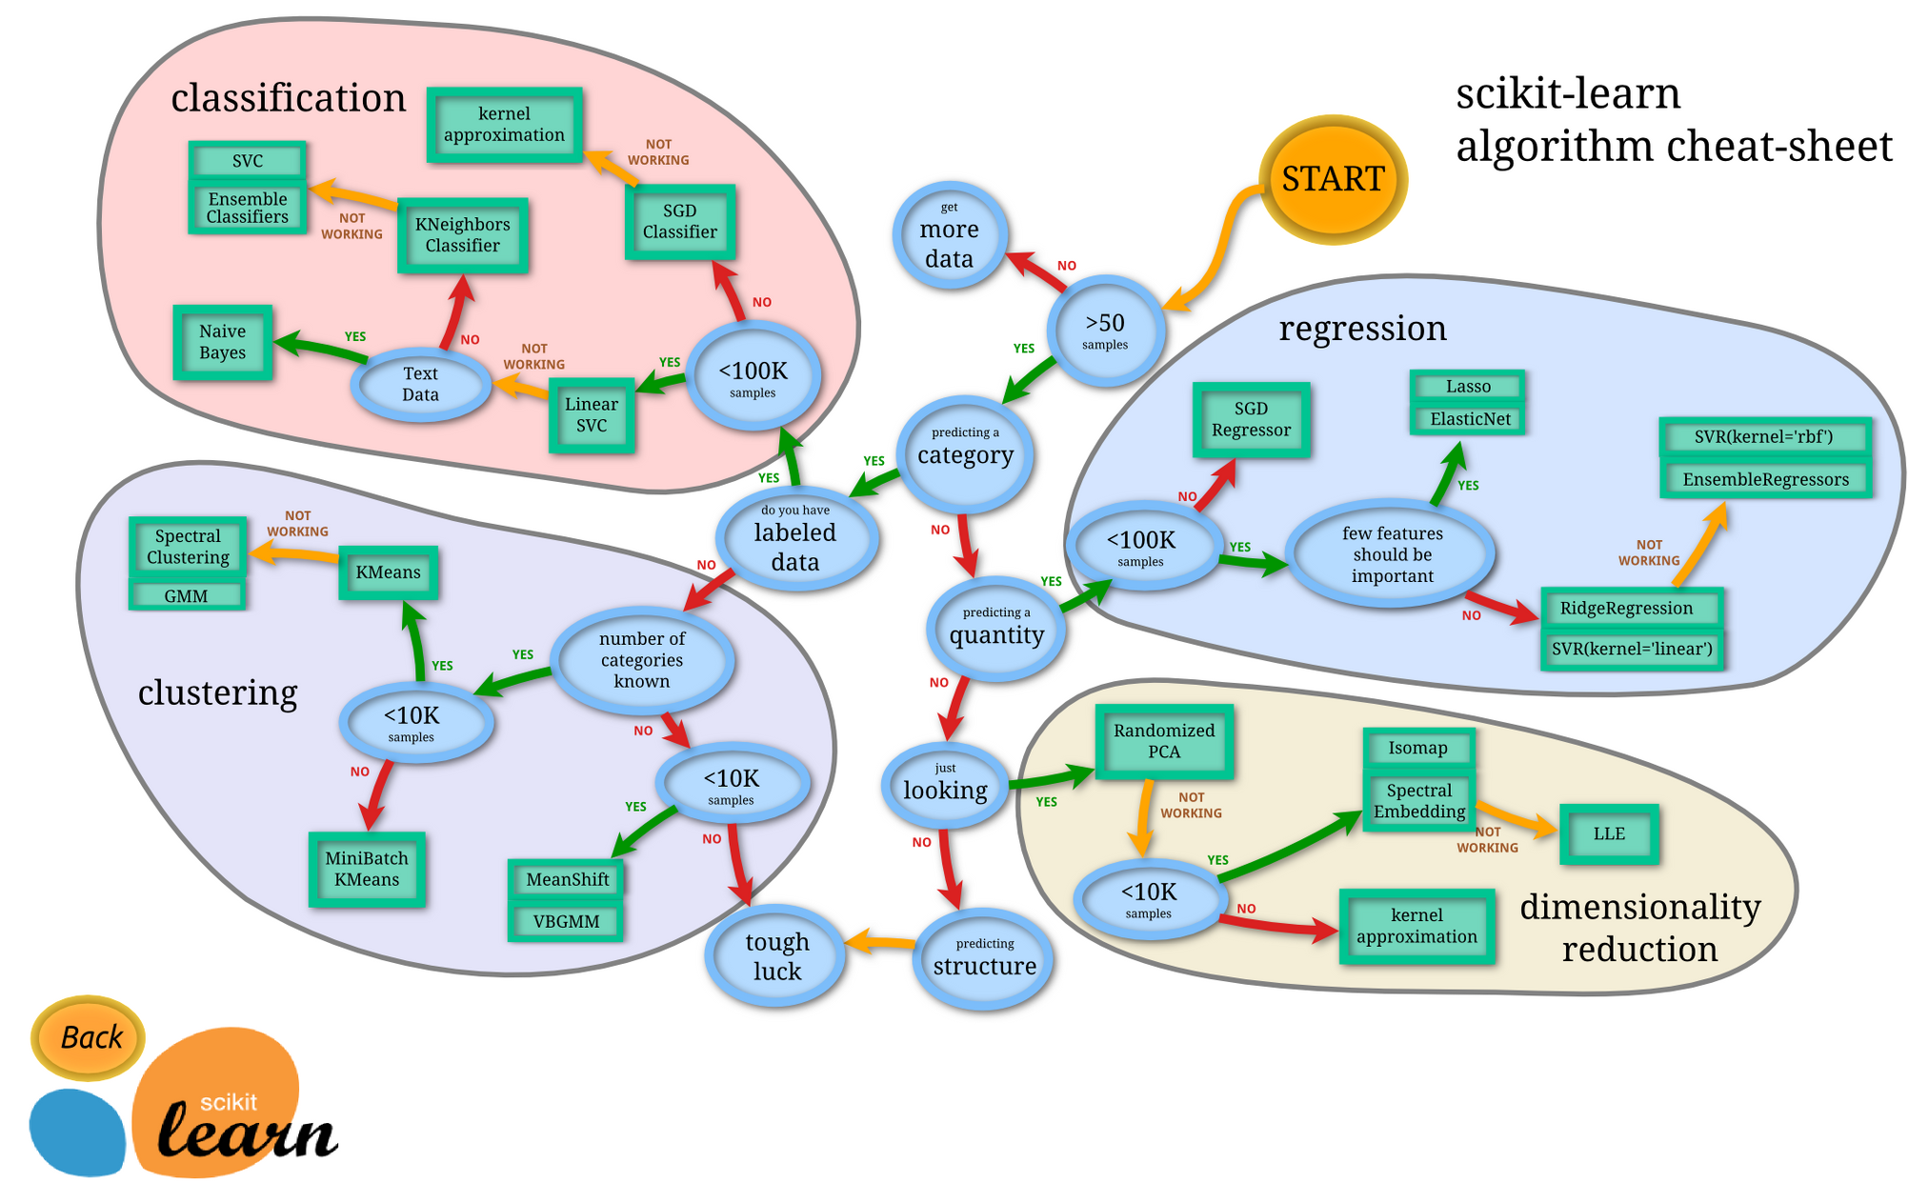

Slide 21

CONCLUSION
I have briefly discussed the importance of EDA in the Data Science pipeline and steps that are involved in Machine Learning Pipeline.
Notes:
Conclusion We have briefly discussed the importance of EDA in the Data Science pipeline and steps that are involved in proper analysis.

Slide 22

Additional Resources
Notes:
Conclusion We have briefly discussed the importance of EDA in the Data Science pipeline and steps that are involved in proper analysis.

Slide 23
Class Notebooks
https://github.com/Africa-Data-School/ADS_Course_Material
Analytics Vidhya
https://www.analyticsvidhya.com/blog/
Sklearn
https://scikit-learn.org/stable/tutorial/machine_learning_map/index.html
©2021 Proprietary and Confidential. All Rights Reserved.
23

